Slide 1
Schedule
15:00 Lecture by Alexandre Antonelli : where do we stand now in terms of biodiversity data?
15:45 Discussion of the lecture and a short break
16:15 Software introduction and demonstration
17:00 Short presentation of the participants and hands-on software exercises
18:45 Wrap up
19:00 Informal joint dinner for those interested.
https://github.com/azizka/
Notes:
Welcome
Presentation + affiliation
Schedule, start with lecture

Slide 2


Biodiversity Data in Ecology and Biogeography
Workshop at the Botanikertagung
Kiel 22. September 2017
Alexandre Antonelli & Alexander Zizka

Slide 3


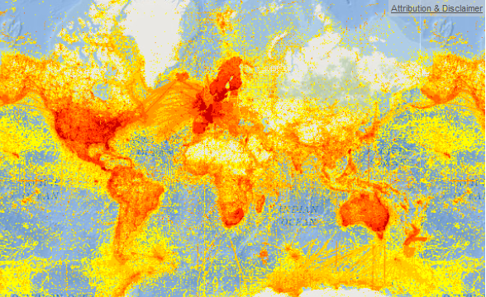






Species distribution data – a revolution
GBIF > 800 M records
Notes:
1st data revolution
GBIF: > 760 million occurrence records

Slide 4
Fantastic!
How can we use these data in biogeography and ecology?

Slide 5
How can we use these data in biogeography and ecology?
Data quality
Bioinformatics capacity
Sampling effort

Slide 6



Software
SpeciesgeocodeR
Infomap Bioregions
SampBias

Slide 7
Töpel, Zizka et al. 2017 Syst Biol
Zizka et al. 2015 bioRxiv

Slide 8
SpeciesgeocodeR
R & Python package for:
Data cleaning
Data Visualization
Data classification

Slide 9
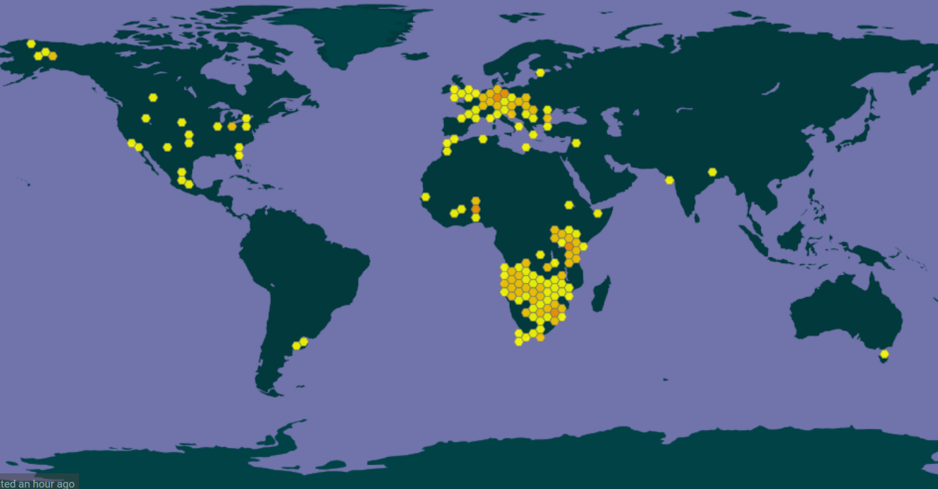
1. Data cleaning

Slide 10
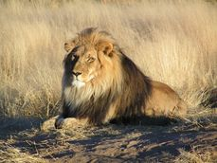
1. Data cleaning

Slide 11
1. Data cleaning - Common coordinate errors
Notes:
So lets start with the potentially problematic coordinates. There are a couple of common problems with coordinates from biological collection datasets, which arise from various sources, but mainly the fact that multiple people and multiple computers work on concstructing these datasets. And the problems occur both in expert curated datasets and in those from public aggregators such as GBIF and you have most likely encountered some of them yourself. So as an example imagine an dataset of occurrence records in South America, could be of a plant genus, that looks like this. Looks quite reasonable, but there a the most common problems hidden in here.
The first one are invalid coordinates, that is nonumeric entries or entries where the decimal point was replaced by a common etc, which you would not even see here
The second one are “zero coordinates” that us ciirdinates that have a plain zero, which is quite unlikely. That would be the three points highlighted here.
Then we have coordinates, that for some reason ended up in the sea, could be due to swaped longitude and latitude
Anotherthing that often happens is, that somewhere along the road, coordinates that just had a country information get coordinates assigned to the country centroids. (Which is fine for some analyses, but for others is fatal)
Similarly coordinates sometimes get assigned to the capital coordinates
Anotherthing tha can happen is that somehow the coordinates to not fit with a country information provided with the record
And a last common issue aer outliers, that occur for some reason. IN that case imagin a species that has a southern, Andean dsitribution like this, and out of a sudden there is one record there.
SO all these things you probably do not want to have in your analyses, but they are hard to find in larger datasets

Slide 12
1. Data cleaning - Common coordinate errors
Kiel

Slide 13
1. Data cleaning - Common coordinate errors
Invalid or missing
Notes:
So lets start with the potentially problematic coordinates. There are a couple of common problems with coordinates from biological collection datasets, which arise from various sources, but mainly the fact that multiple people and multiple computers work on concstructing these datasets. And the problems occur both in expert curated datasets and in those from public aggregators such as GBIF and you have most likely encountered some of them yourself. So as an example imagine an dataset of occurrence records in South America, could be of a plant genus, that looks like this. Looks quite reasonable, but there a the most common problems hidden in here.
The first one are invalid coordinates, that is nonumeric entries or entries where the decimal point was replaced by a common etc, which you would not even see here
The second one are “zero coordinates” that us ciirdinates that have a plain zero, which is quite unlikely. That would be the three points highlighted here.
Then we have coordinates, that for some reason ended up in the sea, could be due to swaped longitude and latitude
Anotherthing that often happens is, that somewhere along the road, coordinates that just had a country information get coordinates assigned to the country centroids. (Which is fine for some analyses, but for others is fatal)
Similarly coordinates sometimes get assigned to the capital coordinates
Anotherthing tha can happen is that somehow the coordinates to not fit with a country information provided with the record
And a last common issue aer outliers, that occur for some reason. IN that case imagin a species that has a southern, Andean dsitribution like this, and out of a sudden there is one record there.
SO all these things you probably do not want to have in your analyses, but they are hard to find in larger datasets

Slide 14
1. Data cleaning - Common coordinate errors
Invalid or missing
Zeros
Notes:
So lets start with the potentially problematic coordinates. There are a couple of common problems with coordinates from biological collection datasets, which arise from various sources, but mainly the fact that multiple people and multiple computers work on concstructing these datasets. And the problems occur both in expert curated datasets and in those from public aggregators such as GBIF and you have most likely encountered some of them yourself. So as an example imagine an dataset of occurrence records in South America, could be of a plant genus, that looks like this. Looks quite reasonable, but there a the most common problems hidden in here.
The first one are invalid coordinates, that is nonumeric entries or entries where the decimal point was replaced by a common etc, which you would not even see here
The second one are “zero coordinates” that us ciirdinates that have a plain zero, which is quite unlikely. That would be the three points highlighted here.
Then we have coordinates, that for some reason ended up in the sea, could be due to swaped longitude and latitude
Anotherthing that often happens is, that somewhere along the road, coordinates that just had a country information get coordinates assigned to the country centroids. (Which is fine for some analyses, but for others is fatal)
Similarly coordinates sometimes get assigned to the capital coordinates
Anotherthing tha can happen is that somehow the coordinates to not fit with a country information provided with the record
And a last common issue aer outliers, that occur for some reason. IN that case imagin a species that has a southern, Andean dsitribution like this, and out of a sudden there is one record there.
SO all these things you probably do not want to have in your analyses, but they are hard to find in larger datasets

Slide 15
1. Data cleaning - Common coordinate errors
Invalid or missing
Zeros
Seas
Notes:
So lets start with the potentially problematic coordinates. There are a couple of common problems with coordinates from biological collection datasets, which arise from various sources, but mainly the fact that multiple people and multiple computers work on concstructing these datasets. And the problems occur both in expert curated datasets and in those from public aggregators such as GBIF and you have most likely encountered some of them yourself. So as an example imagine an dataset of occurrence records in South America, could be of a plant genus, that looks like this. Looks quite reasonable, but there a the most common problems hidden in here.
The first one are invalid coordinates, that is nonumeric entries or entries where the decimal point was replaced by a common etc, which you would not even see here
The second one are “zero coordinates” that us ciirdinates that have a plain zero, which is quite unlikely. That would be the three points highlighted here.
Then we have coordinates, that for some reason ended up in the sea, could be due to swaped longitude and latitude
Anotherthing that often happens is, that somewhere along the road, coordinates that just had a country information get coordinates assigned to the country centroids. (Which is fine for some analyses, but for others is fatal)
Similarly coordinates sometimes get assigned to the capital coordinates
Anotherthing tha can happen is that somehow the coordinates to not fit with a country information provided with the record
And a last common issue aer outliers, that occur for some reason. IN that case imagin a species that has a southern, Andean dsitribution like this, and out of a sudden there is one record there.
SO all these things you probably do not want to have in your analyses, but they are hard to find in larger datasets

Slide 16
1. Data cleaning - Common coordinate errors
Invalid or missing
Zeros
Seas
Country centroids
Notes:
So lets start with the potentially problematic coordinates. There are a couple of common problems with coordinates from biological collection datasets, which arise from various sources, but mainly the fact that multiple people and multiple computers work on concstructing these datasets. And the problems occur both in expert curated datasets and in those from public aggregators such as GBIF and you have most likely encountered some of them yourself. So as an example imagine an dataset of occurrence records in South America, could be of a plant genus, that looks like this. Looks quite reasonable, but there a the most common problems hidden in here.
The first one are invalid coordinates, that is nonumeric entries or entries where the decimal point was replaced by a common etc, which you would not even see here
The second one are “zero coordinates” that us ciirdinates that have a plain zero, which is quite unlikely. That would be the three points highlighted here.
Then we have coordinates, that for some reason ended up in the sea, could be due to swaped longitude and latitude
Anotherthing that often happens is, that somewhere along the road, coordinates that just had a country information get coordinates assigned to the country centroids. (Which is fine for some analyses, but for others is fatal)
Similarly coordinates sometimes get assigned to the capital coordinates
Anotherthing tha can happen is that somehow the coordinates to not fit with a country information provided with the record
And a last common issue aer outliers, that occur for some reason. IN that case imagin a species that has a southern, Andean dsitribution like this, and out of a sudden there is one record there.
SO all these things you probably do not want to have in your analyses, but they are hard to find in larger datasets

Slide 17
1. Data cleaning - Common coordinate errors
Invalid or missing
Zeros
Seas
Country centroids
Capitals
Notes:
So lets start with the potentially problematic coordinates. There are a couple of common problems with coordinates from biological collection datasets, which arise from various sources, but mainly the fact that multiple people and multiple computers work on concstructing these datasets. And the problems occur both in expert curated datasets and in those from public aggregators such as GBIF and you have most likely encountered some of them yourself. So as an example imagine an dataset of occurrence records in South America, could be of a plant genus, that looks like this. Looks quite reasonable, but there a the most common problems hidden in here.
The first one are invalid coordinates, that is nonumeric entries or entries where the decimal point was replaced by a common etc, which you would not even see here
The second one are “zero coordinates” that us ciirdinates that have a plain zero, which is quite unlikely. That would be the three points highlighted here.
Then we have coordinates, that for some reason ended up in the sea, could be due to swaped longitude and latitude
Anotherthing that often happens is, that somewhere along the road, coordinates that just had a country information get coordinates assigned to the country centroids. (Which is fine for some analyses, but for others is fatal)
Similarly coordinates sometimes get assigned to the capital coordinates
Anotherthing tha can happen is that somehow the coordinates to not fit with a country information provided with the record
And a last common issue aer outliers, that occur for some reason. IN that case imagin a species that has a southern, Andean dsitribution like this, and out of a sudden there is one record there.
SO all these things you probably do not want to have in your analyses, but they are hard to find in larger datasets

Slide 18
1. Data cleaning - Common coordinate errors
Invalid or missing
Zeros
Seas
Country centroids
Capitals
Institutions
Notes:
So lets start with the potentially problematic coordinates. There are a couple of common problems with coordinates from biological collection datasets, which arise from various sources, but mainly the fact that multiple people and multiple computers work on concstructing these datasets. And the problems occur both in expert curated datasets and in those from public aggregators such as GBIF and you have most likely encountered some of them yourself. So as an example imagine an dataset of occurrence records in South America, could be of a plant genus, that looks like this. Looks quite reasonable, but there a the most common problems hidden in here.
The first one are invalid coordinates, that is nonumeric entries or entries where the decimal point was replaced by a common etc, which you would not even see here
The second one are “zero coordinates” that us ciirdinates that have a plain zero, which is quite unlikely. That would be the three points highlighted here.
Then we have coordinates, that for some reason ended up in the sea, could be due to swaped longitude and latitude
Anotherthing that often happens is, that somewhere along the road, coordinates that just had a country information get coordinates assigned to the country centroids. (Which is fine for some analyses, but for others is fatal)
Similarly coordinates sometimes get assigned to the capital coordinates
Anotherthing tha can happen is that somehow the coordinates to not fit with a country information provided with the record
And a last common issue aer outliers, that occur for some reason. IN that case imagin a species that has a southern, Andean dsitribution like this, and out of a sudden there is one record there.
SO all these things you probably do not want to have in your analyses, but they are hard to find in larger datasets

Slide 19
1. Data cleaning - Common coordinate errors
Invalid or missing
Zeros
Seas
Country centroids
Capitals
Institutions
Wrong country
Argentina
Chile
Venezuela
Notes:
So lets start with the potentially problematic coordinates. There are a couple of common problems with coordinates from biological collection datasets, which arise from various sources, but mainly the fact that multiple people and multiple computers work on concstructing these datasets. And the problems occur both in expert curated datasets and in those from public aggregators such as GBIF and you have most likely encountered some of them yourself. So as an example imagine an dataset of occurrence records in South America, could be of a plant genus, that looks like this. Looks quite reasonable, but there a the most common problems hidden in here.
The first one are invalid coordinates, that is nonumeric entries or entries where the decimal point was replaced by a common etc, which you would not even see here
The second one are “zero coordinates” that us ciirdinates that have a plain zero, which is quite unlikely. That would be the three points highlighted here.
Then we have coordinates, that for some reason ended up in the sea, could be due to swaped longitude and latitude
Anotherthing that often happens is, that somewhere along the road, coordinates that just had a country information get coordinates assigned to the country centroids. (Which is fine for some analyses, but for others is fatal)
Similarly coordinates sometimes get assigned to the capital coordinates
Anotherthing tha can happen is that somehow the coordinates to not fit with a country information provided with the record
And a last common issue aer outliers, that occur for some reason. IN that case imagin a species that has a southern, Andean dsitribution like this, and out of a sudden there is one record there.
SO all these things you probably do not want to have in your analyses, but they are hard to find in larger datasets

Slide 20
1. Data cleaning - Common coordinate errors
Invalid or missing
Zeros
Seas
Country centroids
Capitals
Institutions
Wrong country
Outliers
Argentina
Chile
Venezuela
Notes:
So lets start with the potentially problematic coordinates. There are a couple of common problems with coordinates from biological collection datasets, which arise from various sources, but mainly the fact that multiple people and multiple computers work on concstructing these datasets. And the problems occur both in expert curated datasets and in those from public aggregators such as GBIF and you have most likely encountered some of them yourself. So as an example imagine an dataset of occurrence records in South America, could be of a plant genus, that looks like this. Looks quite reasonable, but there a the most common problems hidden in here.
The first one are invalid coordinates, that is nonumeric entries or entries where the decimal point was replaced by a common etc, which you would not even see here
The second one are “zero coordinates” that us ciirdinates that have a plain zero, which is quite unlikely. That would be the three points highlighted here.
Then we have coordinates, that for some reason ended up in the sea, could be due to swaped longitude and latitude
Anotherthing that often happens is, that somewhere along the road, coordinates that just had a country information get coordinates assigned to the country centroids. (Which is fine for some analyses, but for others is fatal)
Similarly coordinates sometimes get assigned to the capital coordinates
Anotherthing tha can happen is that somehow the coordinates to not fit with a country information provided with the record
And a last common issue aer outliers, that occur for some reason. IN that case imagin a species that has a southern, Andean dsitribution like this, and out of a sudden there is one record there.
SO all these things you probably do not want to have in your analyses, but they are hard to find in larger datasets

Slide 21
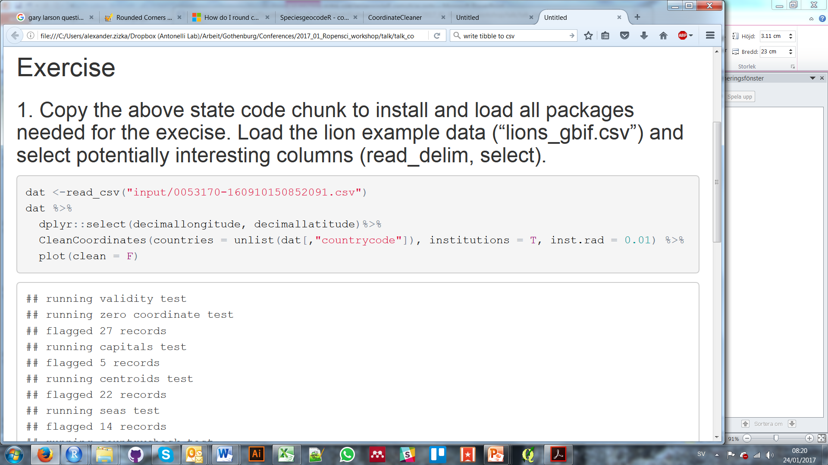
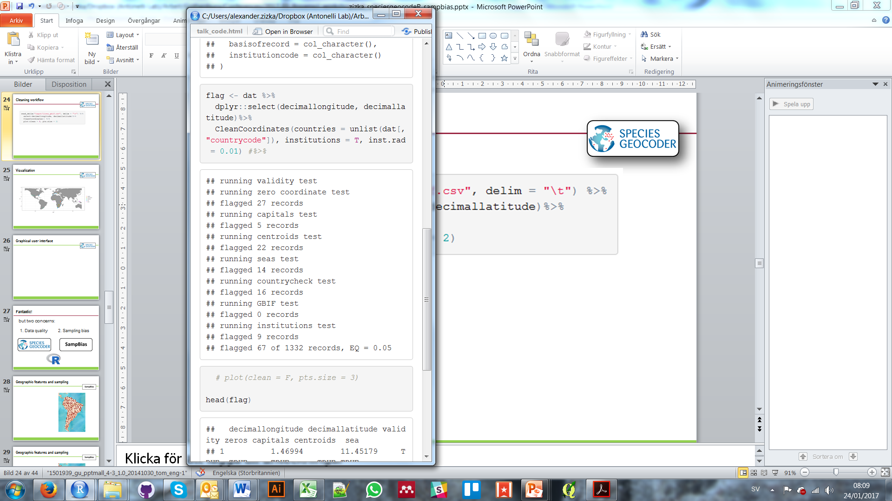
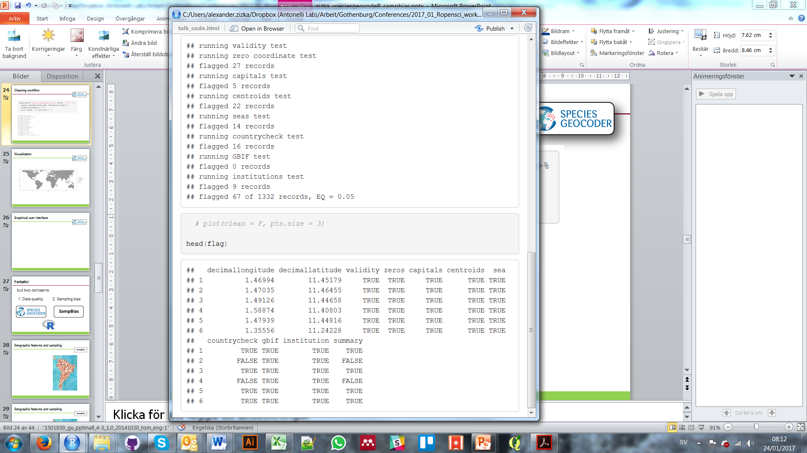
1. Data cleaning - Workflow
https://github.com/azizka/speciesgeocodeR

Slide 22
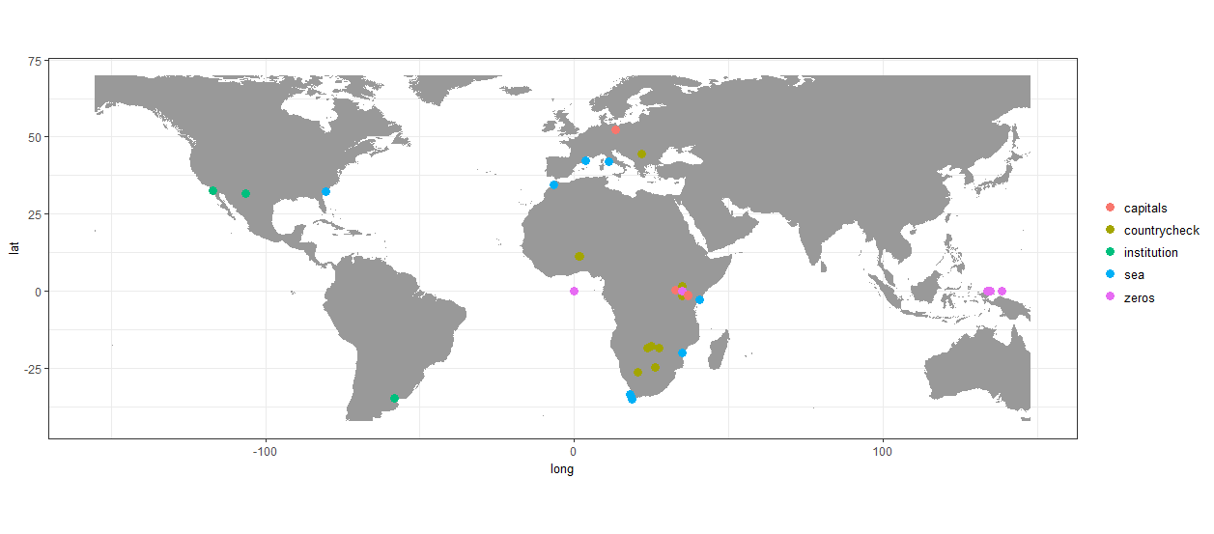
1. Data cleaning - Visualization
Tutorials & documentation:
https://github.com/azizka/speciesgeocodeR

Slide 23
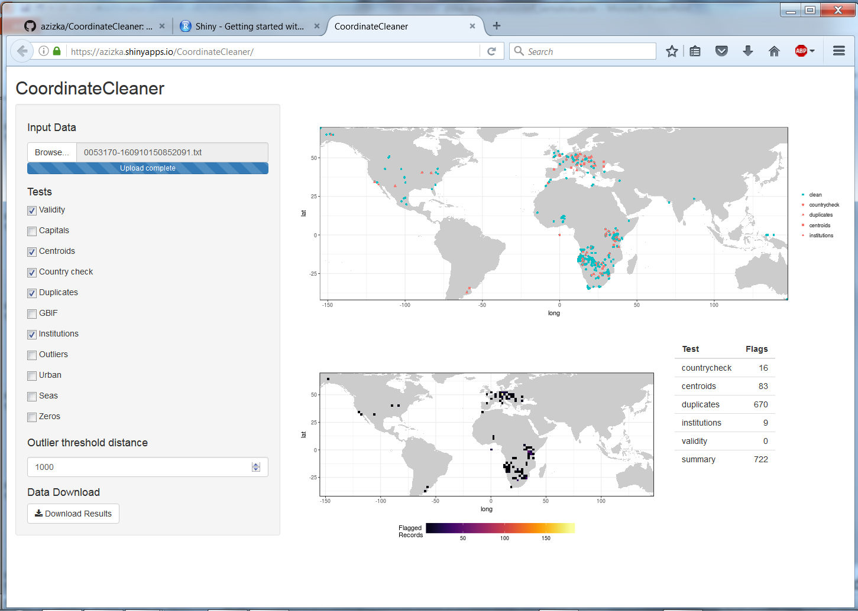
1. Data cleaning – Graphical User Interface
https://azizka.shinyapps.io/CoordinateCleaner/

Slide 24
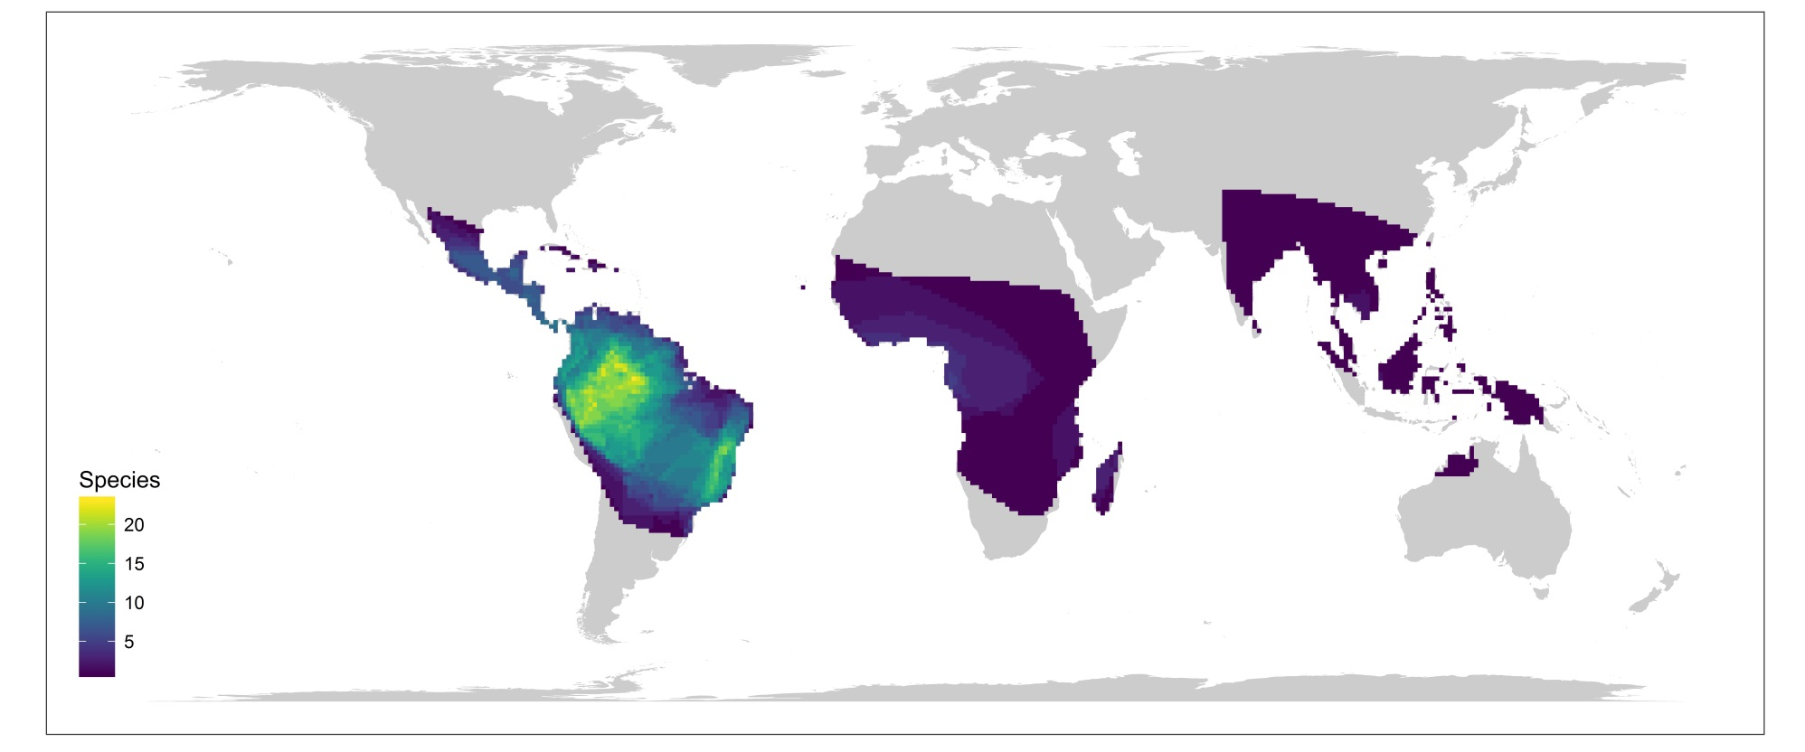
2. Data visualization
Approximate species ranges
Visualize species richness patterns

Slide 25
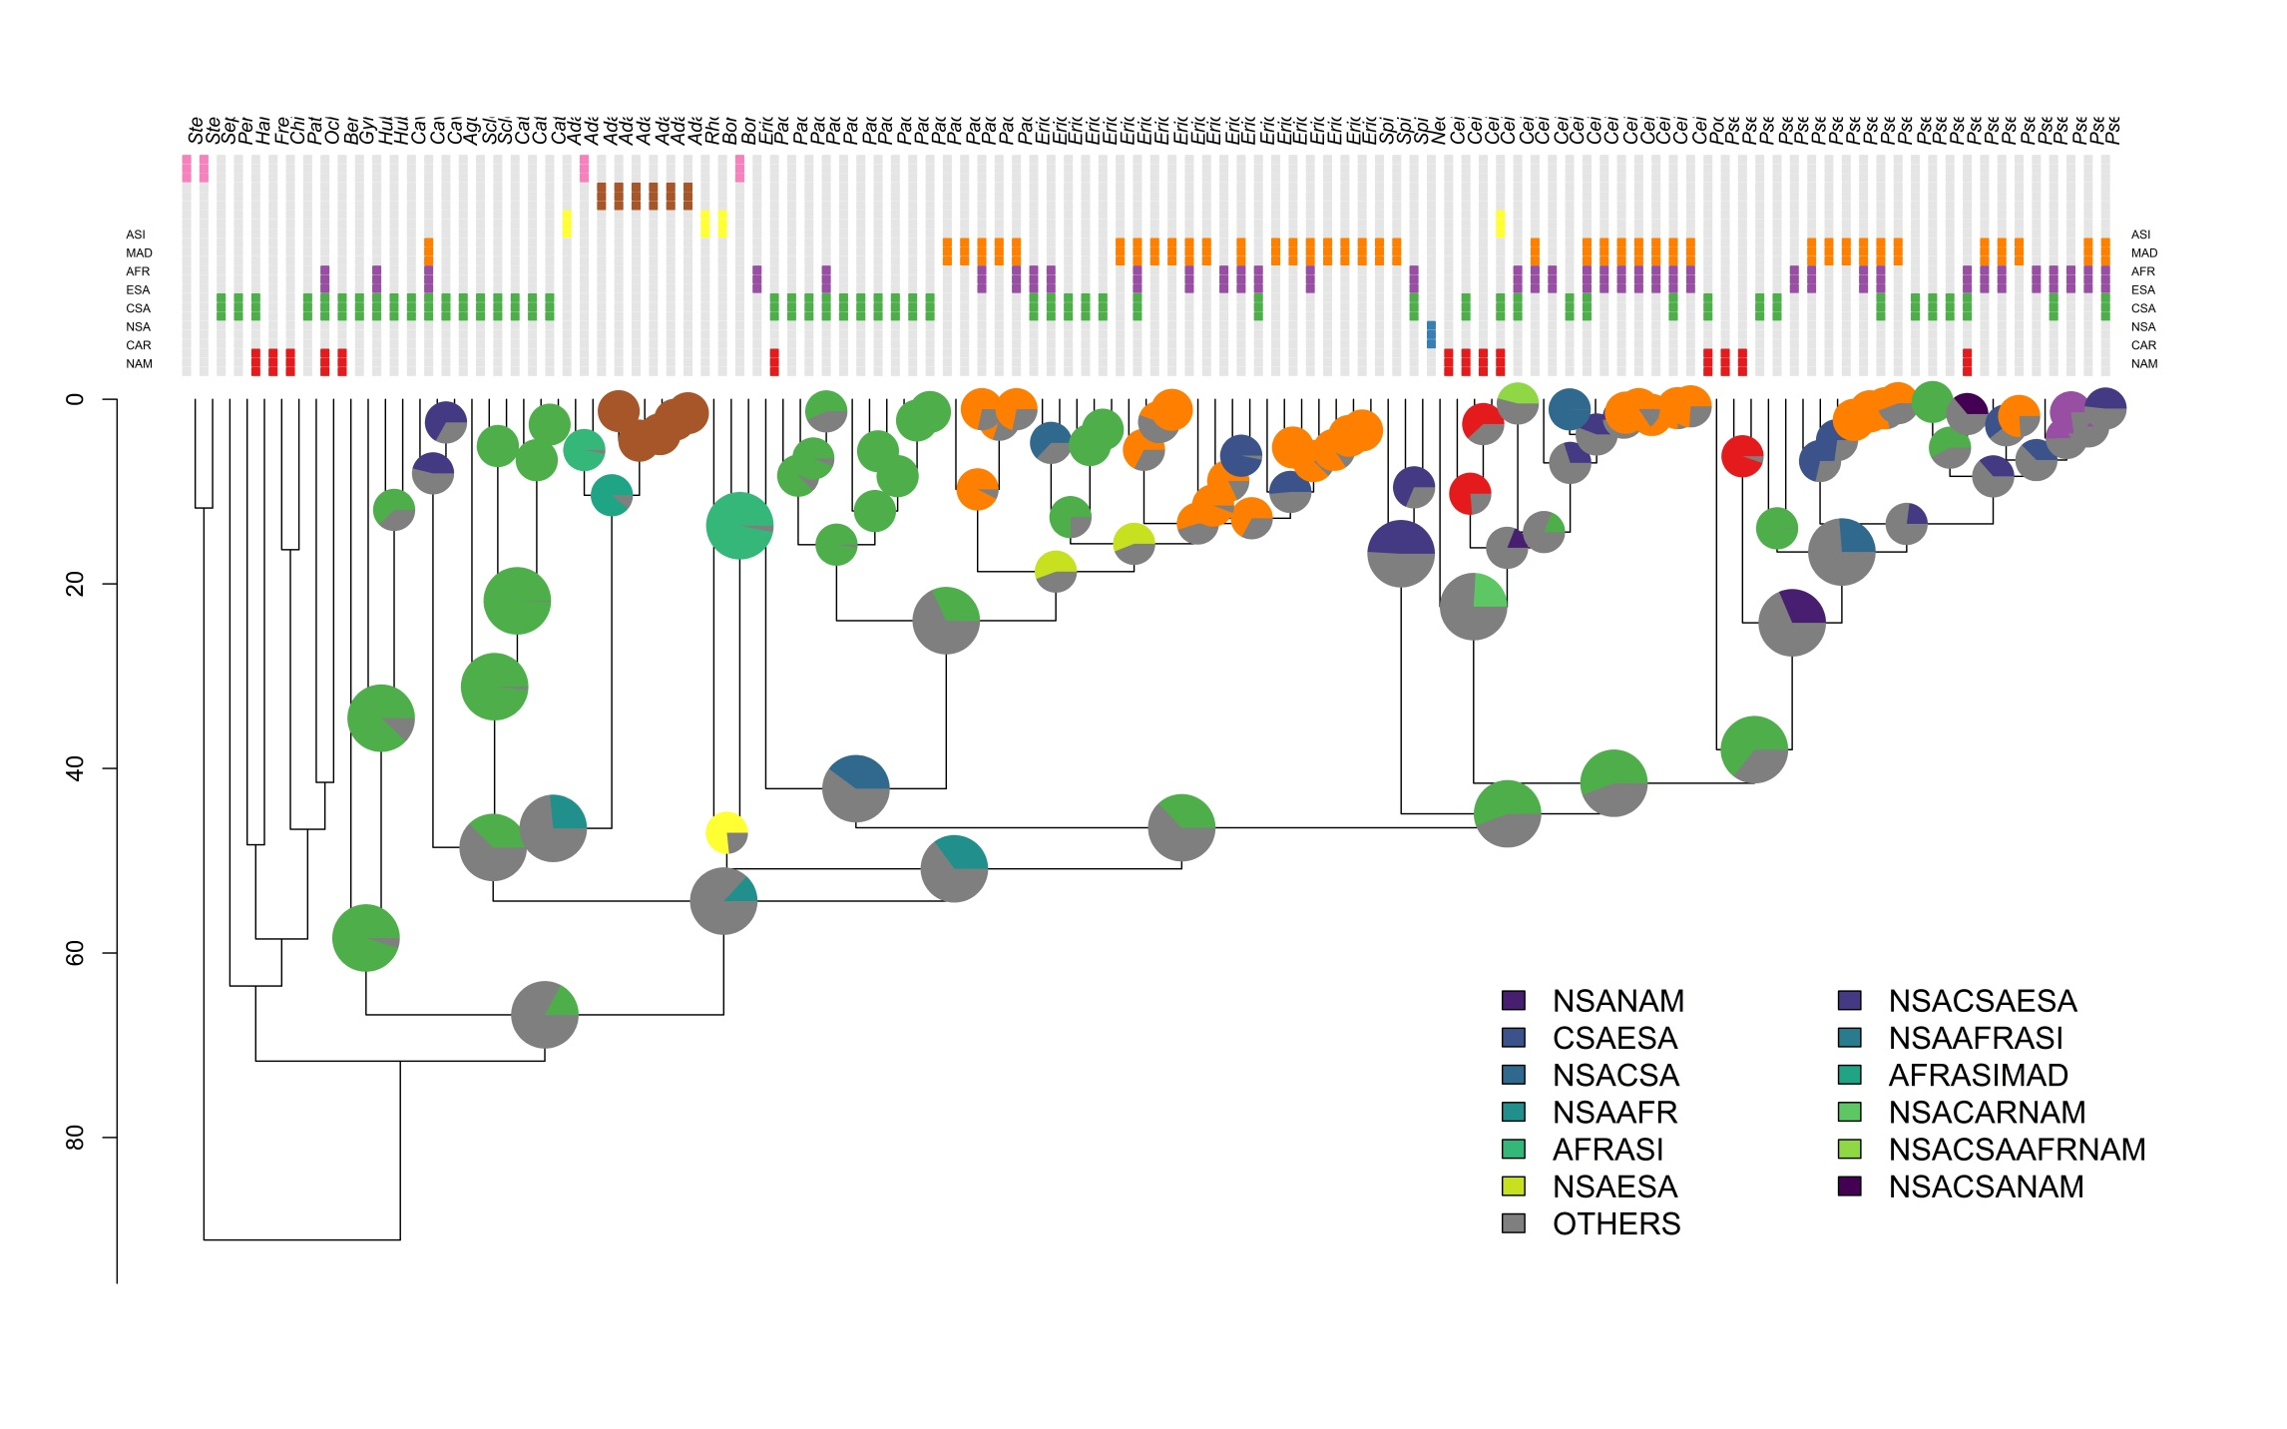
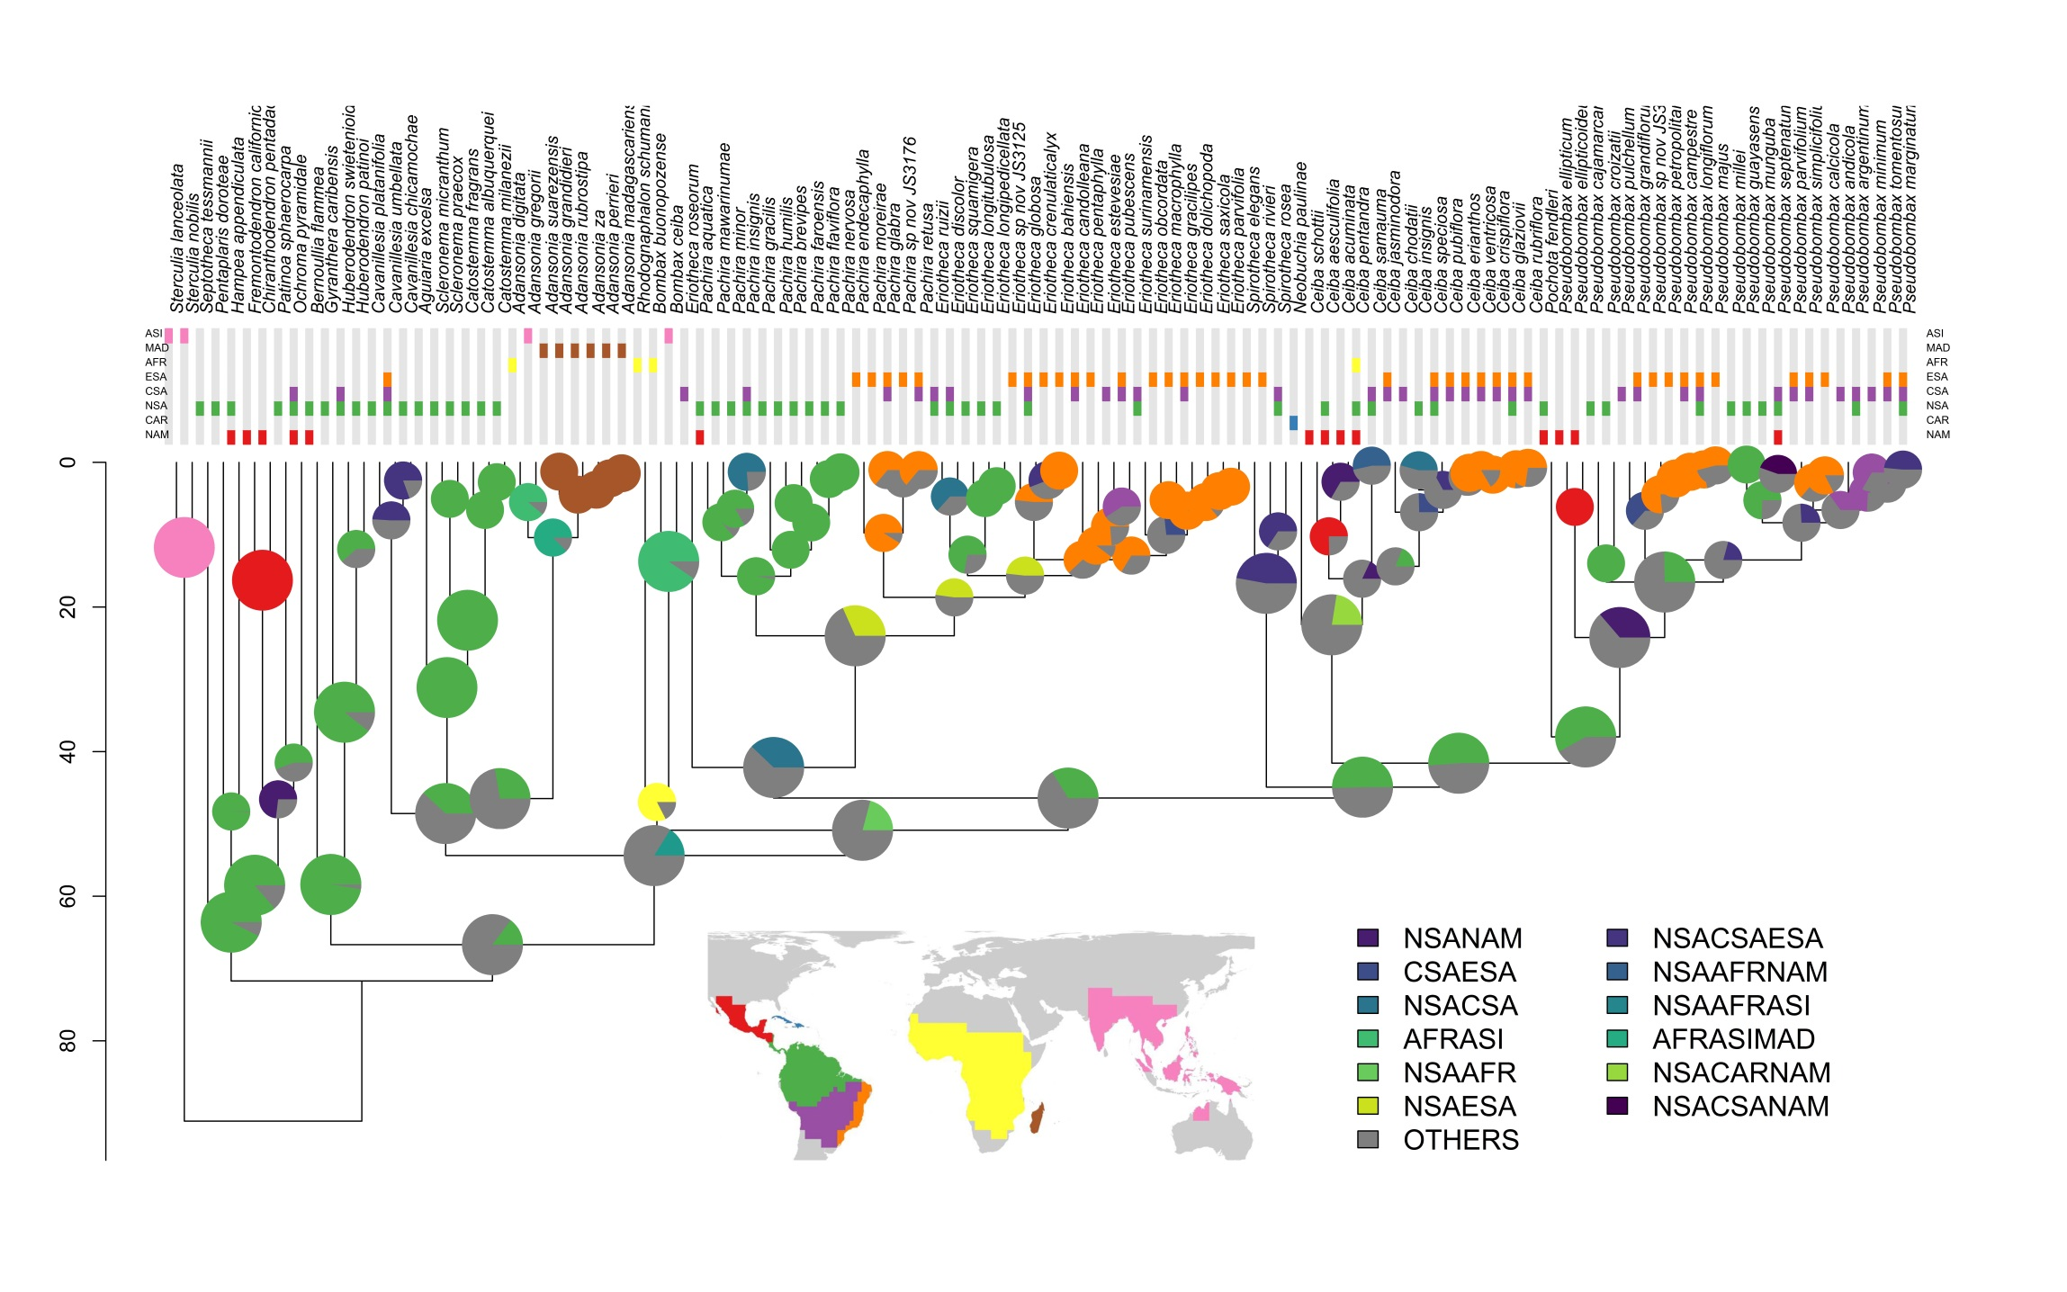
3. Data classification
ASI
MAD
AFR
ESA
CSA
NSA
CAR
NAM

Slide 26
3. Data classification

Slide 27
Vilhena & Antonelli 2015, Nature Com
Edler et al. 2017, Syst Biol

Slide 28

Background
ASI
MAD
AFR
ESA
CSA
NSA
CAR
NAM

Slide 29
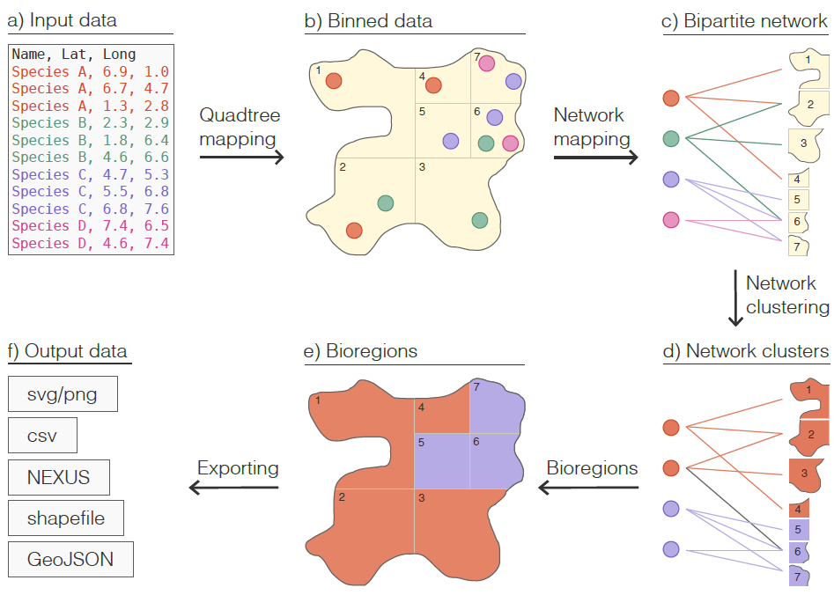

How does it work?

Slide 30
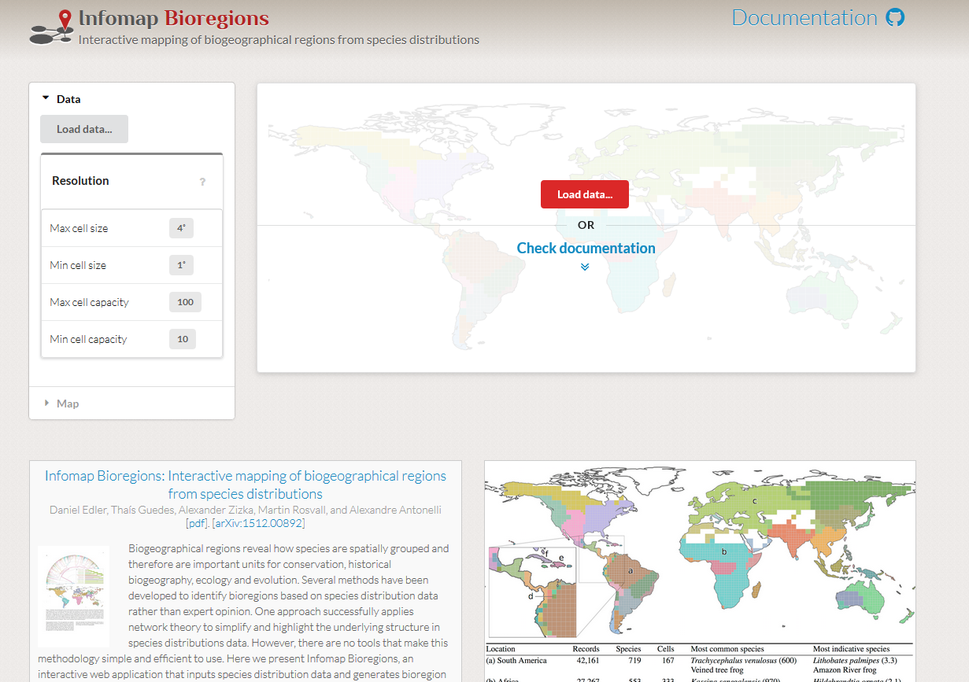
Workflow

Slide 31
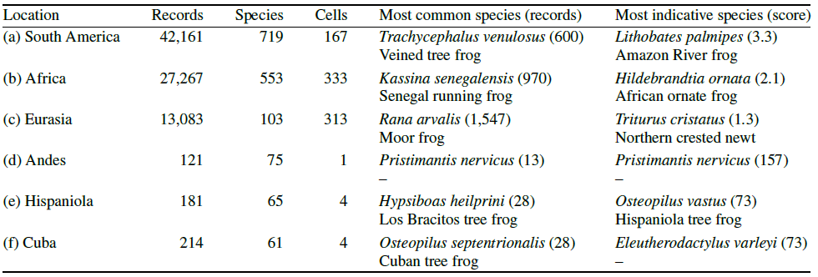
Output
Edler et al. 2017

Slide 32
Beta-version

Slide 33
Background
Relation between anthropogenic geographic features and occurrence records
Based on gazetteers and frequency distributions of distances

Slide 34
Background
Notes:
Now that the problem of problematic coordinates ahs been addressed, we come to the next challenge of biological collection data, which is sampling biases. Sampling biases are inherent to virtually all biological collection datasets, and are mainly due to accessability. SO imagine again our south american plant genus. What we want is something like this, a more or less random sampling, where the occurrence correspond to the ecological niches of the species. What we most of the times have is something like this. That does not look to different on the first view

Slide 35
Background
Notes:
Now that the problem of problematic coordinates ahs been addressed, we come to the next challenge of biological collection data, which is sampling biases. Sampling biases are inherent to virtually all biological collection datasets, and are mainly due to accessability. SO imagine again our south american plant genus. What we want is something like this, a more or less random sampling, where the occurrence correspond to the ecological niches of the species. What we most of the times have is something like this. That does not look to different on the first view

Slide 36
Background
Roads
Notes:
Now that the problem of problematic coordinates ahs been addressed, we come to the next challenge of biological collection data, which is sampling biases. Sampling biases are inherent to virtually all biological collection datasets, and are mainly due to accessability. SO imagine again our south american plant genus. What we want is something like this, a more or less random sampling, where the occurrence correspond to the ecological niches of the species. What we most of the times have is something like this. That does not look to different on the first view

Slide 37
Background
Roads
Cities
Notes:
Now that the problem of problematic coordinates ahs been addressed, we come to the next challenge of biological collection data, which is sampling biases. Sampling biases are inherent to virtually all biological collection datasets, and are mainly due to accessability. SO imagine again our south american plant genus. What we want is something like this, a more or less random sampling, where the occurrence correspond to the ecological niches of the species. What we most of the times have is something like this. That does not look to different on the first view

Slide 38
Background
Roads
Cities
Airports
Notes:
Now that the problem of problematic coordinates ahs been addressed, we come to the next challenge of biological collection data, which is sampling biases. Sampling biases are inherent to virtually all biological collection datasets, and are mainly due to accessability. SO imagine again our south american plant genus. What we want is something like this, a more or less random sampling, where the occurrence correspond to the ecological niches of the species. What we most of the times have is something like this. That does not look to different on the first view

Slide 39
Background
Roads
Cities
Airports
Rivers
Sampling increases with accessibility
Notes:
Now that the problem of problematic coordinates ahs been addressed, we come to the next challenge of biological collection data, which is sampling biases. Sampling biases are inherent to virtually all biological collection datasets, and are mainly due to accessability. SO imagine again our south american plant genus. What we want is something like this, a more or less random sampling, where the occurrence correspond to the ecological niches of the species. What we most of the times have is something like this. That does not look to different on the first view

Slide 40
Background

Slide 41
Background

Slide 42
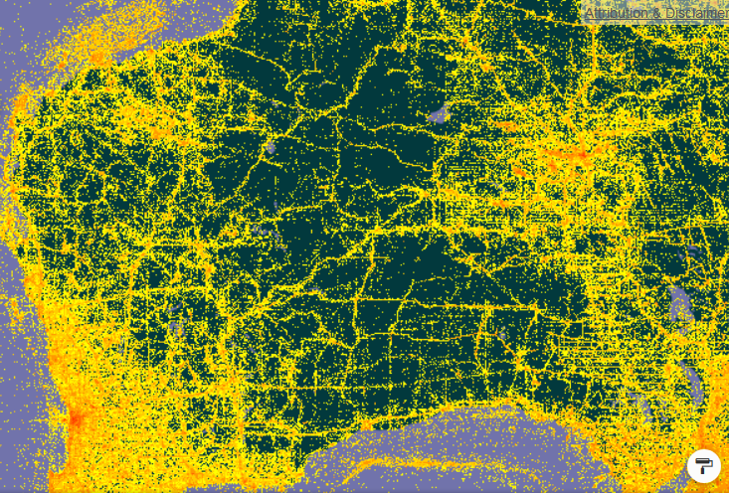
Background

Slide 43
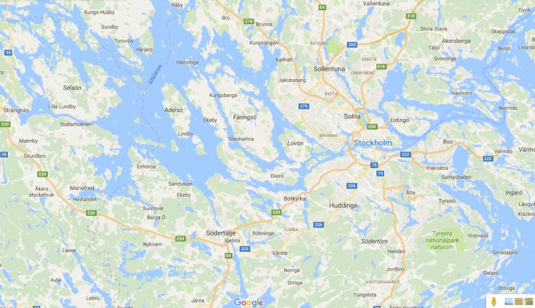
How does it work?
Gazetteer (e.g. streets)

Slide 44
How does it work?
Gazetteer (e.g. streets)

Slide 45
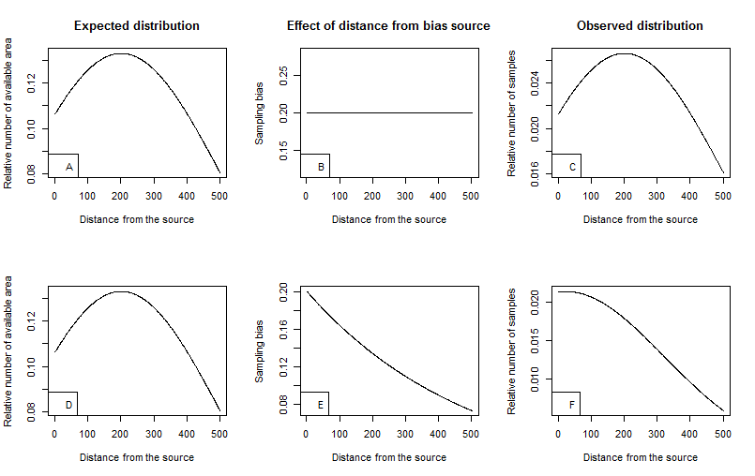
How does it work?
Gazetteer (e.g. streets)
Minimum distance
Expected distribution

Slide 46
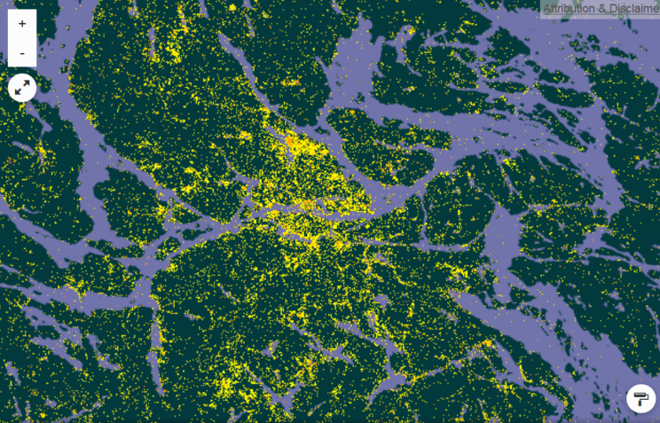
How does it work?
Gazetteer (e.g. streets)
Occurrences
Minimum distance
Expected distribution

Slide 47
How does it work?
Gazetteer (e.g. streets)
Occurrences
Minimum distance
Expected distribution
Observed distribution
Observed distribution

Slide 48
How does it work?

Slide 49
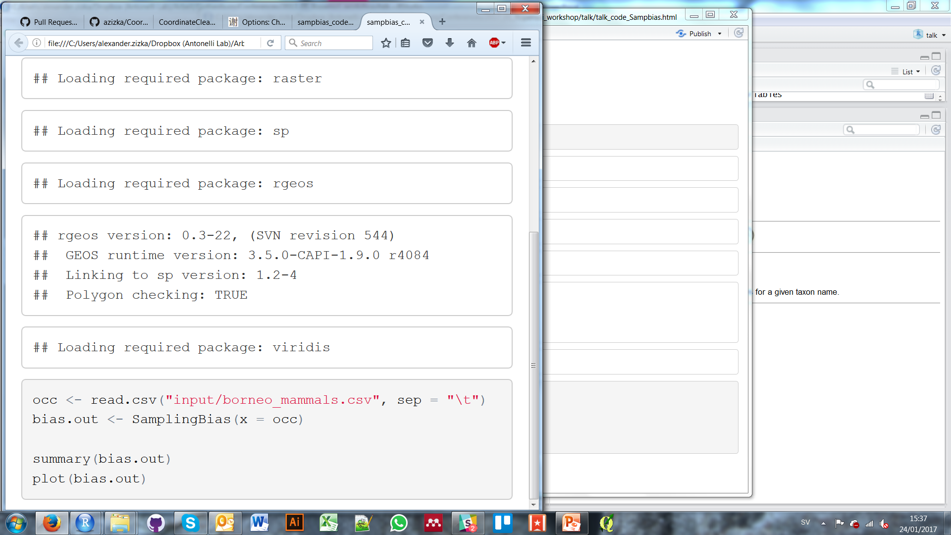
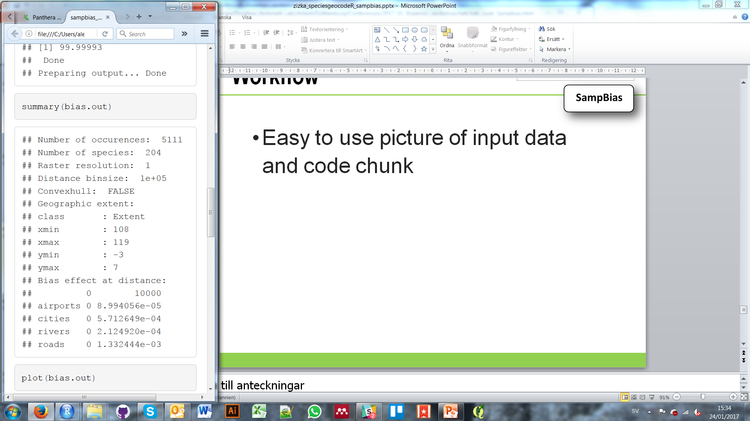
Workflow

Slide 50
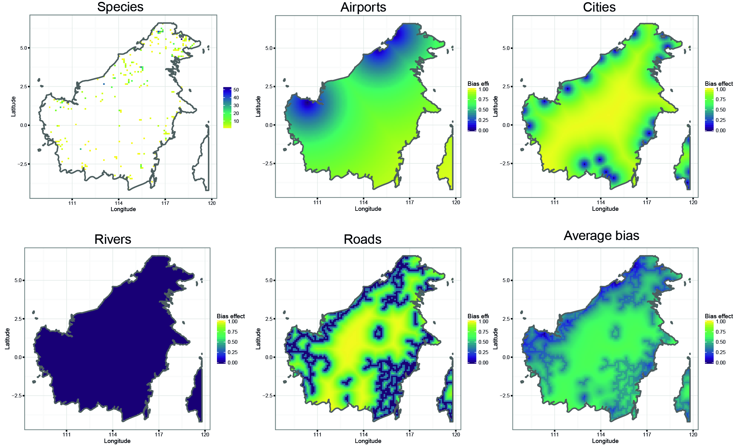
Output

Slide 51
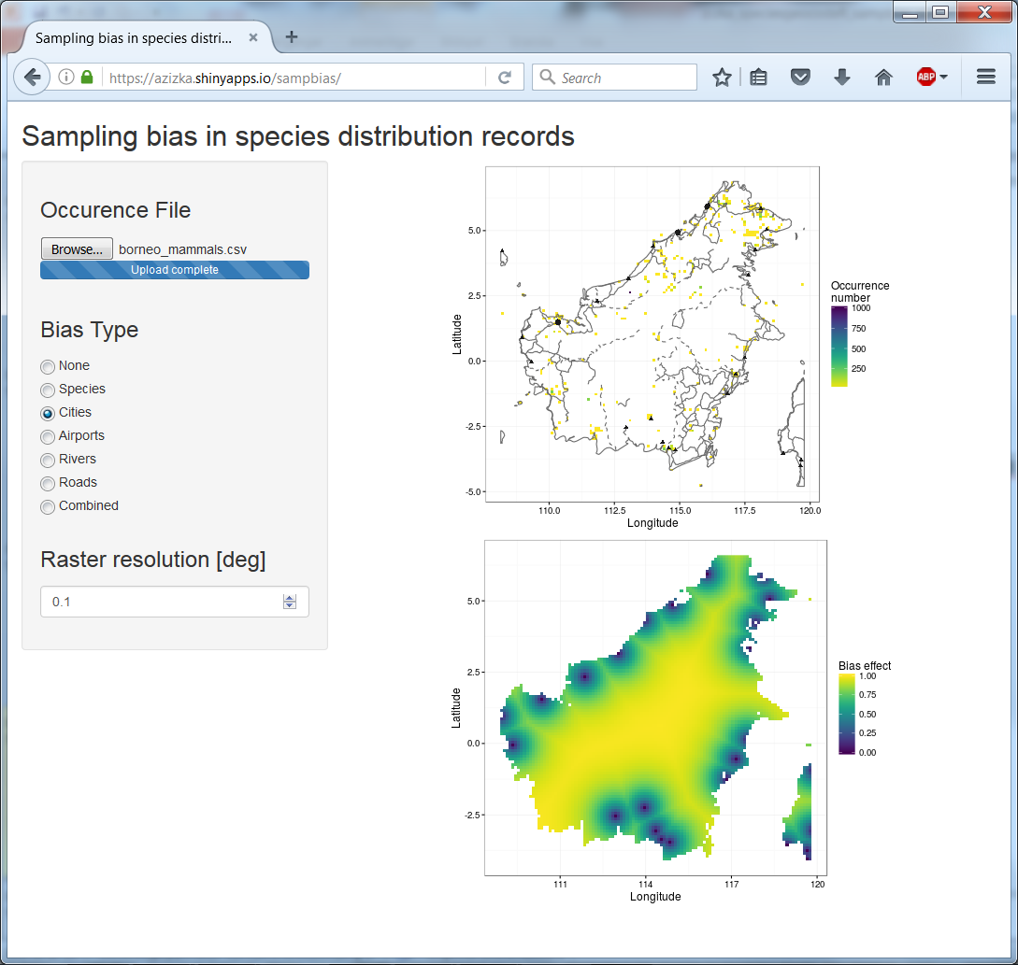
Shiny app
https://azizka.shinyapps.io/sampbias/

Slide 52
Exercises
1. Downloading geographic occurrence data from GBIF (R)
2. Geographic cleaning of occurrence data (R & Graphical User Interface)
3. Species richness maps and range size estimation from point occurrences (R)
4. Taxon-specific bioregionalization (GUI)
5. Classifying species into discrete areas for historical biogeography (R)
6. Quantifying collection bias related to accessibility (R & GUI)

Slide 53
Exercises
1. Downloading geographic occurrence data from GBIF (R)
2. Geographic cleaning of occurrence data (R & Graphical User Interface)
3. Species richness maps and range size estimation from point occurrences (R)
4. Taxon-specific bioregionalization (GUI)
5. Classifying species into discrete areas for historical biogeography (R)
6. Quantifying collection bias related to accessibility (R & GUI)

Slide 54
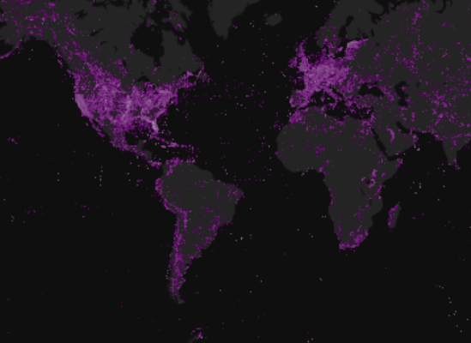
Vielen Dank!
http://antonelli-lab.net/resources.php
https://cran.rstudio.com/web/packages/speciesgeocodeR/
https://github.com/azizka/speciesgeocodeR
https://github.com/azizka/sampbias
Notes:
SO if you are working with coordinates and biological collections check out samp bias and Species geocoder. Speciesgeocoder is availble from CRAN or the webpage of the Antonelli lab, and sampbias is available as beta version from Github and will be released in February. If you have questions, please do not hesitaed to drop me a line. Muchas Gracias!

